Slide 1
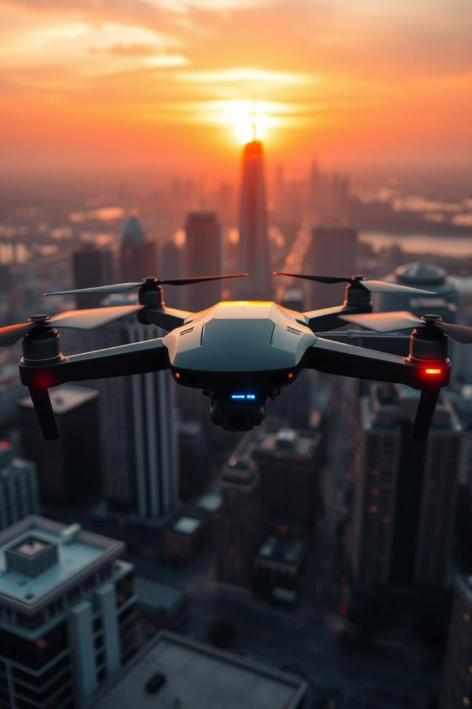
ECHO-GUARD : Autonomous Surveillance and Management Drone
Trash Detection | Traffic Violation Monitoring | Person Detection
Presented by: TEAM PHANTOMPULSE (solo)

Slide 2
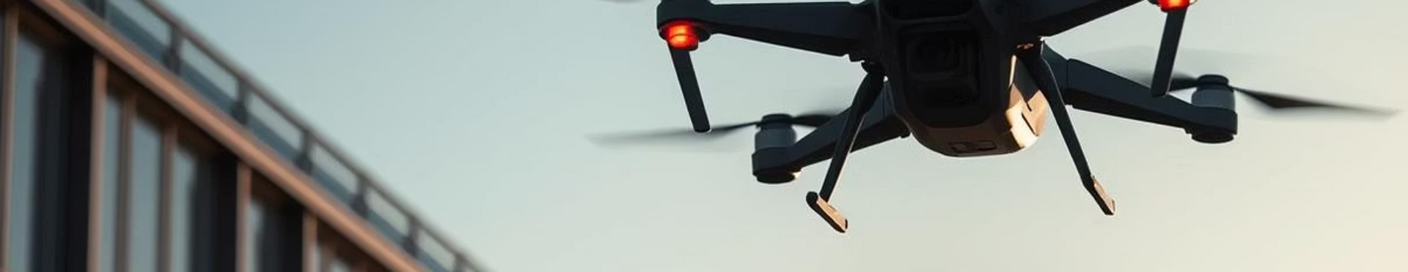
Introduction
Fully Autonomous
Pre-scripted Flight
Automatic Takeoff & Landing
No manual control needed
Follows a fixed route precisely
Returns to original launch point

Slide 3

Project Overview
Trash Management
Traffic Monitoring
Person Detection
Detect and report litter automatically
Identify parking violations and report
Locate specific individuals in public areas

Slide 4
Trash Management
Detection
Action
Onboard camera with AI processing
Marks GPS location
Identifies trash on streets
Sends SMS and call to cleaning crew
Files complaint if trash persists

Slide 5
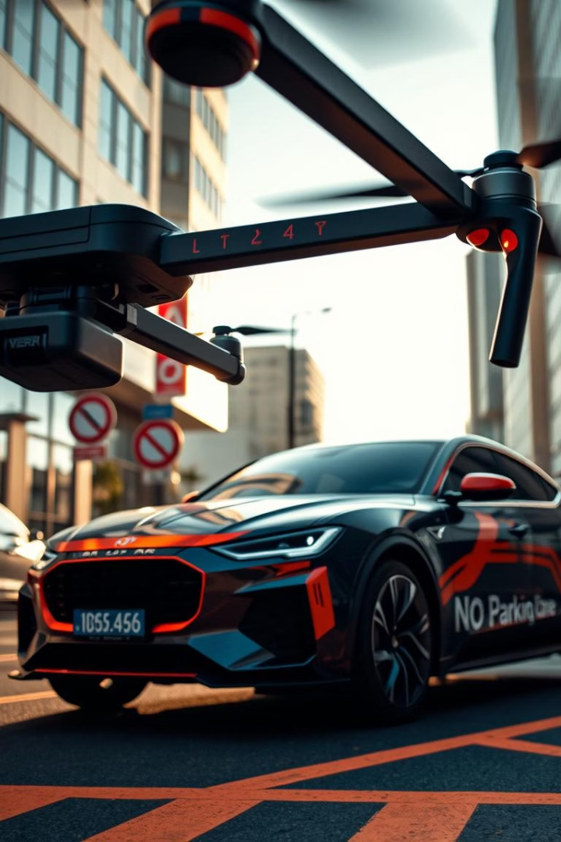




Traffic Violation Monitoring
Violation Detection
Number Plate Capture
Automated Reporting
Identifies illegal parking spots
Photographs vehicle license plates
Uploads reports to Firebase backend
Authority Notification
Calls traffic enforcement officials

Slide 6
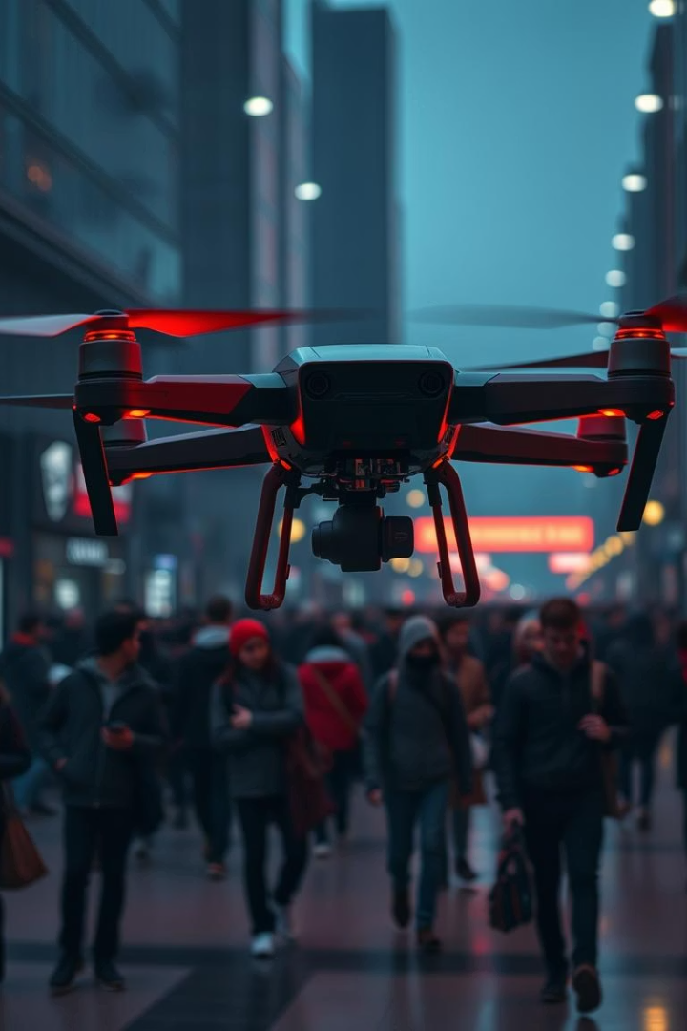
Person Detection
Database Matching
Compares detected faces to a stored list
Real-Time Monitoring
Operates continuously in public spaces
Immediate Alerts
Notifies authorities on person detection
Record Keeping
Updates detection logs in Firebase

Slide 7





Conclusion
Complete Automation
Minimizes manual city monitoring
Reduced Human Effort
Efficient resource utilization
Enhanced City Management
Improves cleanliness, traffic, safety
AI and IoT Integration
Empowers smarter urban infrastructure

Slide 8

Thank You
Questions?

